Slide 1
BOLT-ON, COMPACT AND RAPID PROGRAM SLICING FOR NOTEBOOKS
Sophie Prahia

Slide 2
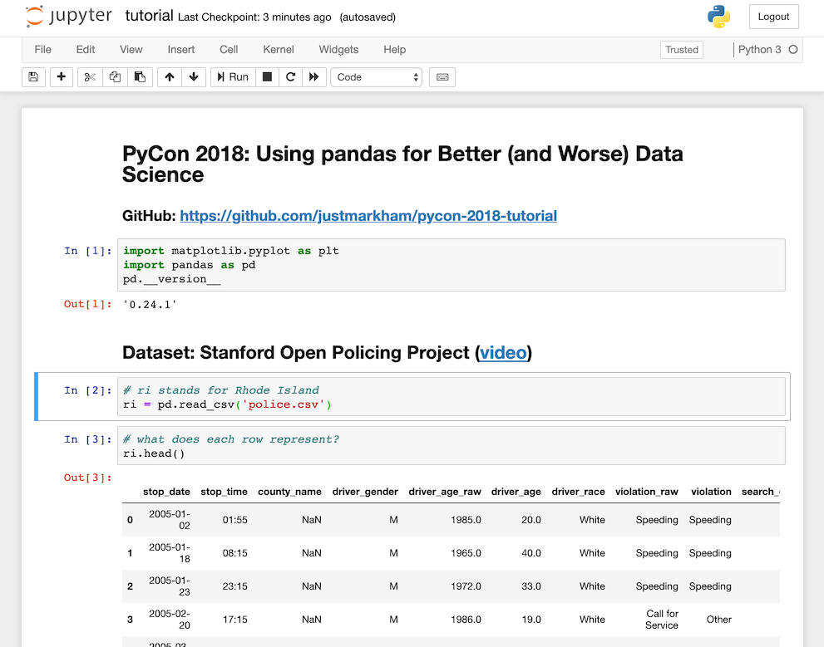
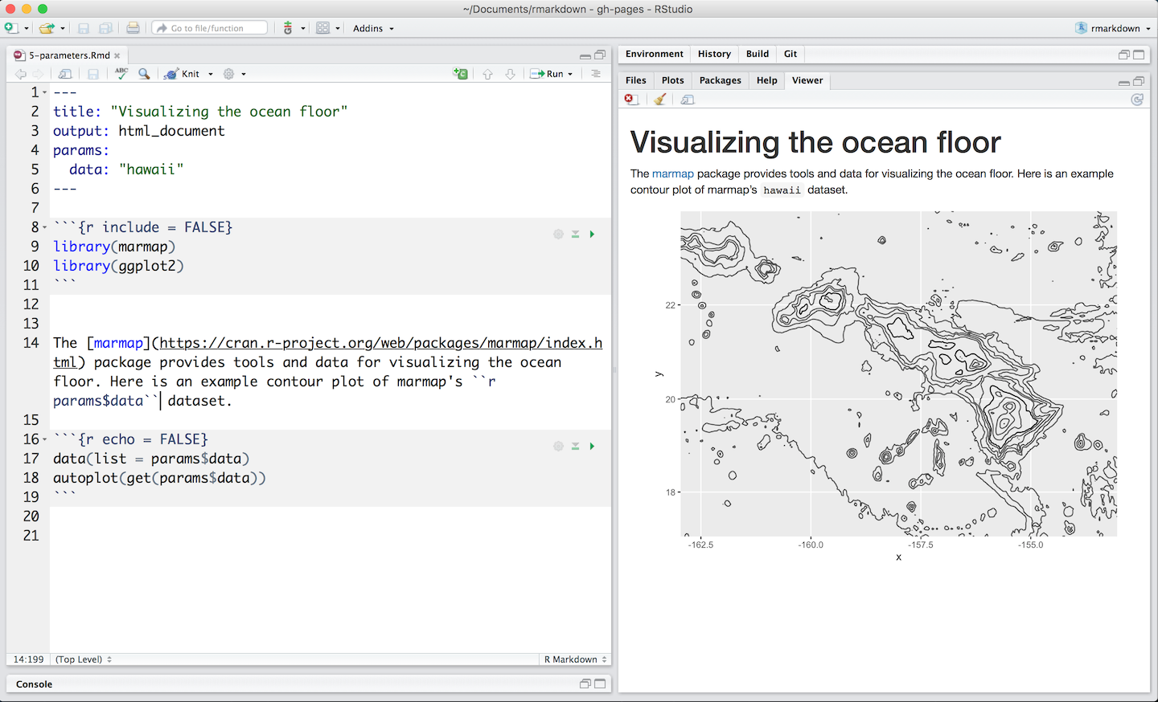




Computational notebooks
Notes:
Let’s talk about Computational notebooks. How many of you have used at least once, for example, MATLAB, Jupyter Notebook, R Markdown? A computational notebook is an environment for writing a document. It allows the author to insert code and add comments. The notebooks are made of small parts of code, called “cells”. The user can run each cell independently. This platform is particularly well-suited for data science work, because it is well suited for exploratory data analysis.

Slide 3
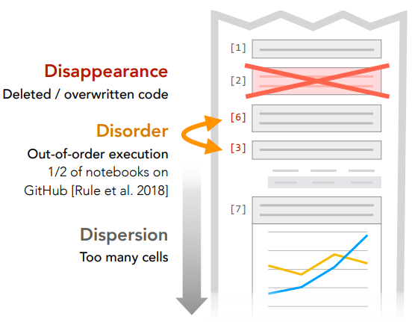
Messy!
A WEEK LATER 1. How did I produce this result? 2. Didn't I have a better version of this? 3. What can I get rid of?
The flexibility is also a downside, leading to messy code.
Accumulate unnecessary elements, including visible code and hidden program state .
Difficulty understanding how the code is executed, potentially leading to confusion or incorrect findings.
Notes:
The flexibility of notebooks is also a downside, leading to messy code. Those notebooks have the tendency to gather unnecessary elements, including visible code and hidden program state . These shortcomings can make it difficult to comprehend how the code is executed, potentially leading to confusing or incorrect findings.

Slide 4

Overview
1. The problem - Computational notebooks are messy
2. The goal – developing a tool to create small and accurate slices of the notebook, when needed. In that case, we can follow dependencies, and include just the statements that affect some calculation or are affected by it.
3. The main challenges creating a tool for improving messy notebooks –
How to handle code with dynamic behavior, since it introduce dynamic data dependencies
How to create the tool portable
Notes:
We talked about the problem –computational notebooks are often becoming messy.
Overall, the goal is to develop a tool that can create small and accurate slices of the notebook, when needed.
In that case, we can follow dependencies, and include just the statements that affec some calculation or are affected by it.
We are going to discuss two main challenges of creating such tool – how to handle code with dynamic behavior, and make the tool portable.

Slide 5
Overview
4. The solution – Nbslicer, a slicer tool optimized for computational notebooks.
5. The techniques Nbslicer uses –
program slicing, both dynamic and static
instrumenting on higher level representation of the code,
leveraging dynamic metadata information
6. Evaluation of Nbslicer effectiveness
Notes:
I am going to present Nbslicer, which is a slicer optimized for Python Notebooks.
We are going to talk about the techniques this tool uses, when the primary one is program slicing
Finally , we will see some evaluation of NBslicer effectiveness.

Slide 6
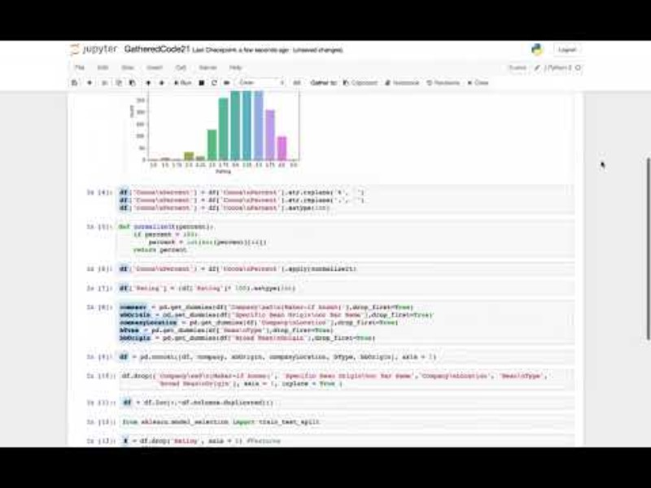

Slide 7

What is Program Slicing?
Program slicing is an analysis technique that isolates parts of a program tied to a specific computation
Program slice- A program slice is a subset of the statements in a program that may affect the value of a particular variable, computed at some point of interest.
Constructs a
Notes:
What is program slicing ? Program slicing is an analysis technique that isolates parts of a program tied to a specific computation. It helps with understanding and debugging the program. Current approaches to improve messy notebooks are build on program slicing, which answers queries about the dependencies among a program's variables.
Program slicing technique constructs a program slice. A program slice refers to a subset of a program's statements that may affect the values of a particular variable computed at a specific point on interest. (In other words, program slicing is the computation of the set of program statements, the program slice, that may affect the values at some point of interest)

Slide 8
Program slicing
Backward slicing
Forward slicing
Forward slice - includes all the that are influenced by the values of certain variables at a specific location in the code. (cells affected by the "rerun" of an earlier cell)
Backward slice - includes all the statements that contribute to the computation of a particular variable, from the point of interest. (historical cell dependencies)
Notes:
Program slicing includes both backward and forward slicing. A backward slice includes all the statements that contribute to the computation of a particular variable, from the point of interest. A forward slice includes all the statements in a program that are influenced by the values of certain variables from the point of interest. Forward and backward slicing focus on dependencies on different directions.
Questions ?

Slide 9
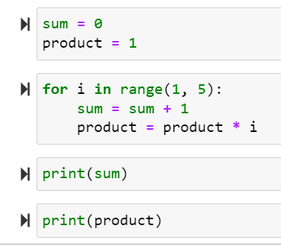
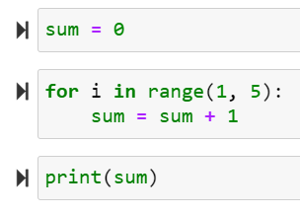
Program Slicing Example
Program slice on statement: print(sum)
Remember! Making the slice more compact makes it more efficient to re-execute while preserving accuracy.
Notes:
Lets take a look on the code on the right side. Assume we want create a slice on the statement print(sum)
The slice includes only the relevant statements contributing to the calculation of the sum variable. Other statements are not included in the slice.
Remember! Making the slice more compact makes it more efficient to re-execute while preserving accuracy

Slide 10

Dynamic VS Static Program Slicing
static program slicing - applied on the source code with no additional information.
Dynamic slicing - uses details from a specific run of a program
dynamic program slice – consists only the statements that truly impact a variable's value at a certain point in the program for that specific run.
static program slice - consists of all statements that may affect the value of variable v in a statement x.
The motivation for using dynamic programming - Static slices may be imprecise and include redundant code.
Notes:
Program slicing can be either static or dynamic. static program slicing- applied on the source code with no other information than the source code. Static program slice consists all the statements that may affect the value of a variable in a specific statement. On the contrary, dynamic slicing uses details from specific execution of the program. Dynamic program slice consists only the statements that truly impact the variable’s value. The motivation for using dynamic programming - Static slices may be imprecise and include redundant code.
Questions so far ?

Slide 11
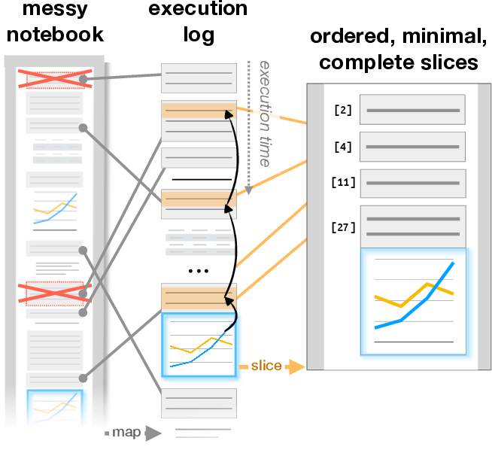
Notebook-Centric Slicing: Challenges
Notes:
It is difficult to achieve small and accurate slices in practice without noticeable degradation of existing notebooks performance. In few more slides, we are going to meet NBSLICER- a dynamic slicer optimized for the notebook setting resolving dynamic data dependencies.
Now, we are going to discusses the main challenges the developers met while developing NBSLICER.

Slide 12

Challenge 1: Small and accurate program slices
In many cases, the static slicing technique will yield overly-conservative (and therefore larger than necessary) slices.
One approach to reduce slice is to leverage dynamic slicing. Dynamic slicing infers data dependencies using the actual runtime state of the notebook’s execution log (useful for code with dynamic behavior).
Dynamic slicing is useful for handling dynamic behavior ( resolving dynamic data dependencies), whereas static slicing struggles with it.
Notes:
It is not difficult to construct a case wherein the static slicing technique will yield much larger slices than necessary. One way to reduce the slice size while preserving correctness is to leverage dynamic slicing. Dynamic slicing is useful for handling dynamic behavior, whereas static slicing struggles with it.

Slide 13
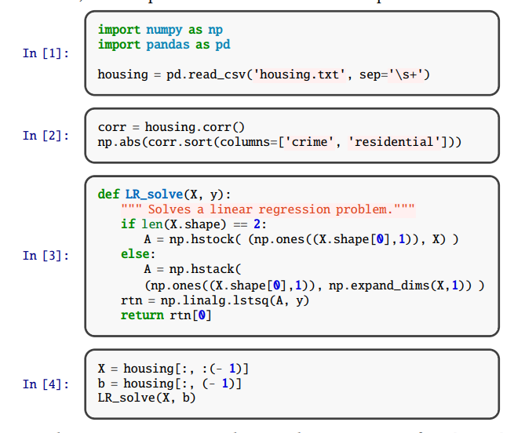

Example
Example of such dynamic behavior
The user runs into an error (there was a typo of np.hstock in cell 3) , motivating them to rerun cells 3 and 4 (as cells 5 and 6, respectively) after fixing. a backward slice of cell 6, would be:
When running nbslicer , the dynamic slice contains only cells 1, 5, cell 6 .
A static slicer would include the entire execution log in its slice, including cells 3 and 4, which were run before the typo was fixed.
5
6
Notes:
Here is an example for such dynamic behavior
There is a typo in cell 3,np.hstock instead of np.hstack After fixing, the user would want to re-run cells 5 and 6. Lets try to create backward slice of cell 6 (reconstruct the output of the last cell)
In Nbslicer, only cells 1 5 6 will be in that slice. However, a static slicer would include the entire execution log (cells 1 to 6).
In the context of a function, if it modifies the state, it means it alters the values of variables or objects outside of its own scope, potentially impacting the overall program.

Slide 14

Example
Example of such dynamic behavior
NBslicer uses dynamic analysis to track dependencies at runtime. It can infer that the np and pd objects in cells 1-2 just reference external libraries and don't modify state.
Modification of the state by a function means it changes the values of variables or objects beyond its own scope.
Though dynamic slicing can reduce slice size while preserving correctness, it requires deep modifications to the underlying interpreter, presenting problems from both performance and portability.
Notes:
The reason to that difference is that Nbslicer can figure out that numpy and Pandas (in cell 2) are external libraries, that don’t modify the state. Thus, Nbslicer can exclude cell 2, 3 and 4. They don’t contribute to the output in cell 6.
However, solely on static information, static programing won’t be able to infer that. So what is the issue? The issue with dynamic programming is that it requires modification to the interpreter, which is a problem of both performance and portability.

Slide 15
Challenge 2: Balancing Performance with Portability
Dynamic slicing requires visibility into execution code to catch runtime data dependencies, which leads to significant overhead. supports tracing of individual bytecode operations using built-in system tracing utilities, leads to major slowdowns - with Python >= 3.8 , the slowdowns are 100× or more, makes it infeasible.
Notes:
Dynamic slicing comes with the drawback of significant overhead, since it requires visibility into execution code to infer runtime data dependencies.
For example, in Python ≥3.8 leveraging this approach leads to notable slowdowns of 100× or more supports tracing of individual bytecode operations via builtin system tracing utilities [4] — functionality upon which runtime data dependency tracking could be implemented — but we found that leveraging this approach leads to slowdowns of 100× or more.

Slide 16

An alternative approach (to using the built-in tracing utilities) , involves instrumenting the interpreter itself in a lower-level language such as C. However, users would need to re-download a new interpreter for each new Python version release. From a maintainer standpoint, supporting multiple versions of Python interpreter is less than ideal.
Quick summary :
The challenge is to detect and resolve dynamic data dependencies , with reasonable overhead
Notes:
An alternative approach is to instrument the interpreter itself in a lower-level language. However, users would need to re-download a new interpreter, every time a new version of Python is released. Supporting this is less than ideal. Quick summary : The challenge is to detect and resolve dynamic data dependencies , with reasonable overhead
alternative approach - Python's built-in tracing utilities for instrumenting

Slide 17
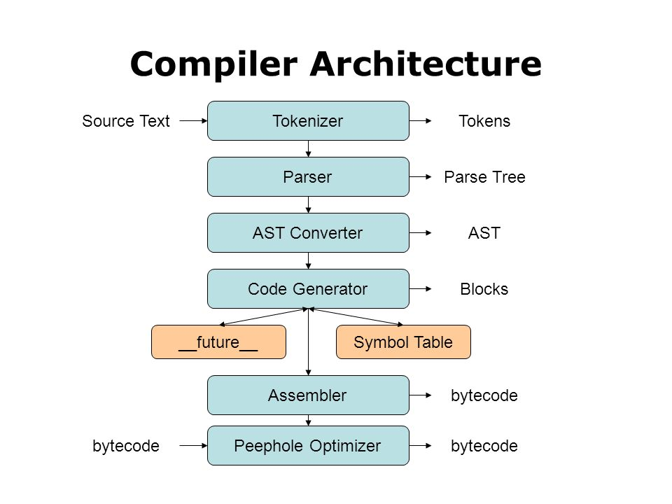


Python Bytecode
Python bytecode is a low-level representation of the Python source code.
After the AST is generated , the next step in the execution process is to convert the AST to bytecode. This process is known as compilation.
Notes:
Lets meet two important terms on very high level: Python bytecode is a low-level representation of the Python source code.
After the AST is generated (we are going to understand this term next), we convert it to byte-code. This process is called compilation.

Slide 18
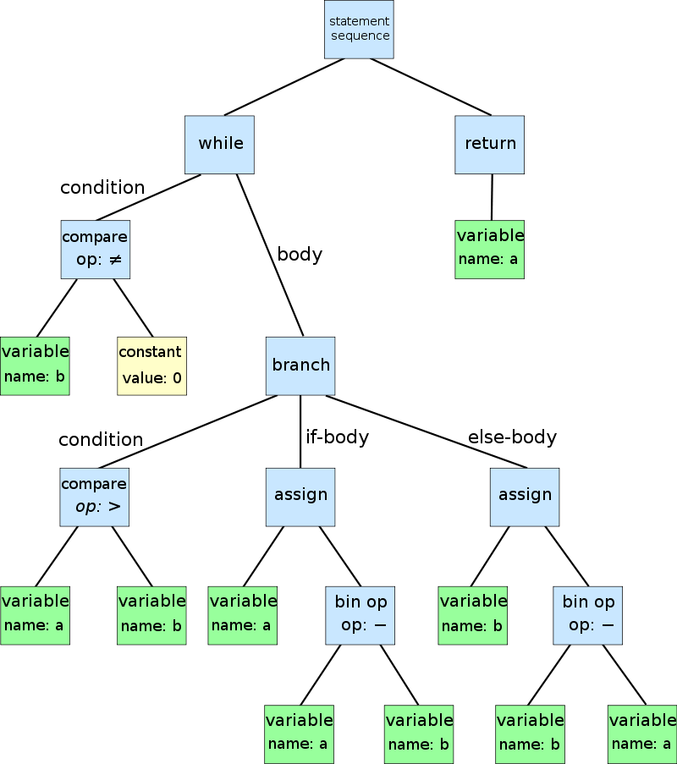
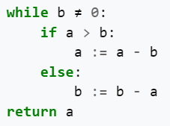
AST - Abstract Syntax Tree
Tree-structured representation of code.
Each node stands for a construct in the code – e.g., function, loop, or operation
Data dependencies can be inferred by inspecting AST - the structure of the AST provides useful insights, including the relationships between variables
The AST represents the high-level structure of the source code, In comparison to python-bytecode
Notes:
An abstract syntax tree (AST) is a tree representation of code. Each node represents an element in the code, such as a function, loop, or operation.
Data dependencies can be inferred by inspecting AST - the AST structure provides useful insights , including the relationships between variables.
This is a higher level representation in comparison to python bytecode.

Slide 19
NBSLICER: A Hybrid Static-Dynamic Slicer
The primary innovation - instrumenting code at the AST level rather than the Python bytecode.
Notes:
Nbslicer is a hybrid static-dynamic slicer optimized for interactive notebooks. The primary innovation of nbslicer instruments code at the level of the AST rather than the Python bytecode.

Slide 20

Nbslicer’s Instrumentation Strategy
1. Switchable: The AST-level instrumentation can be selectively enabled and disabled to constrain the runtime overhead it induces.
2. Augmentation: Nbslicer augments ASTs to expose specific dynamic dependencies. The transformation adds information to data without changing the program's behavior.
Notes:
Here is the Nbslicer Instrumentation strategy :
The AST-level instrumentation can be enabled and disabled as needed, to control its overhead. When enabled, the AST is enhanced in order to capture dynamic dependencies. This additional information would be hard to achieve only by using static analysis.

Slide 21
3. Static Analysis: A static analyzer runs on augmented sub-trees to analyze code structure.
4. Dynamic Dependency Handling: the static analyzer skips subtrees marked as having dynamically - resolved data dependencie, as Nbslicer manages dynamic data dependencies separately.
Notes:
Next, a static analyzer runs on these augmented trees. When the static analyzer encounters subtrees marked "dynamic", it skips them. This is because NBslicer handles dynamic data dependencies separately.

Slide 22
Example – Call nodes
Nbslicer attempts to resolve dynamic data dependencies involved in Call nodes; For example, in our earlier example, it will resolve dependencies involved with the statement
Using static slicing, the call to ones() and hstack() functions would be included in the slice, since they are function calls so they could modify state.
However, NBslicer can infer (through its rules or annotations) that Numpy functions like ones() and hstack() don’t modify the global state , so it will not include a dependency edge from np to np .
Notes:
Here, Nbslicer attempts to resolve dynamic data dependencies involved in Call nodes. normally in static slicing, the call() to ones and hstack() functions would be included in the slice, since they could modify state. However, nbslicer can infer that Numpy functions like ones() and hstack() don’t modify the global state.
So, it will not include a dependency edge from np to np. This allows nbslicer to produce a more precise and compact slice.

Slide 23

Switchable Instrumentation
Disabled when performance would suffer (e.g., in tight loops , repeated function calls)
Re-enabled when the additional overhead would no longer adversely impact the user experience (e.g.,at the start of a new basic block).
To assist this switchable instrumentation, It is vital to maintain a correspondence between executed instructions and the program’s AST .
Notes:
This instrumentation can be disabled when performance would suffer , for example in repeated function calls, and re-enabled when the additional overhead would no longer harmfully impact the user experience. To enable this switchable instrumentation, It is vital to maintain a correspondence between executed instructions and the AST .
It is for this reason that Nbslicer operates at the level of the program’s AST rather than at the level of bytecode. an instrumented AST can reference its original form. On the other hand, bytecode lacks metadata for linking with the program's AST.

Slide 24

Data Dependency
Data Dependency (definition):
A variable y is data-dependent on variable x if the same program statement both reads from x and writes to y. For example , y = 2x
Notes:
data dependency - A variable y is data-dependent on variable x if the same program statement both reads from x and writes to y. A control dependency between two instructions exists when the execution of one instruction depends on the outcome of another instruction.

Slide 25
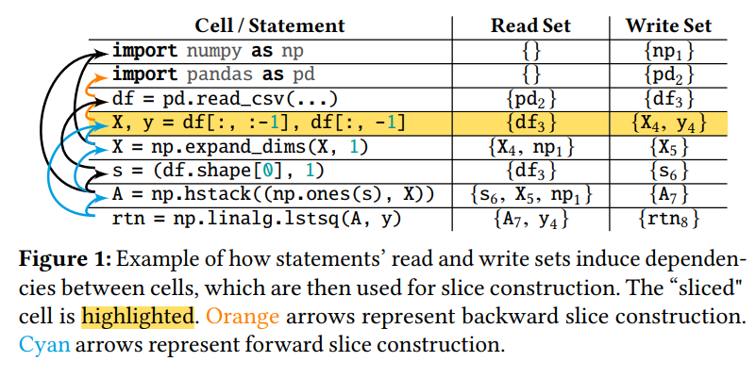
Data Dependency Example
The subscripts (number attached to each variable)- connect the variables to the cell that produced that specific version.
Remember - Read Set and Write Set = Symbol Information
For the highlighted cell c4, there is a data dependency from df3 to each of X4 and y4
In general, every single-statement cell has data dependencies from each variable in its read set to each variable in its write set.
Notes:
the subscripts connect each variable to the cell that produced that specific version.
Here, for the highlighted cell c4, there is a data dependency from df3 to each of X4 and y4 . In general every single statement cell has data dependencies from each variable in its read set to each variable in its write set.
The backward slice is constructed by transitively following the arrows pointing from c4 (colored in orange), and the forward slice is constructed by transitively following the arrows pointing to c4 (colored in blue).

Slide 26
Problem Statements
Suppose we have a notebook session S whose execution log is composed of cells {c1,c2,c3,...,cn }, and we are interested in computing slice T .
Problem 1 (backward slicing): For any ck ∈S, construct a minimal (in terms of the number of cells) slice T ⊆ S such that T includes every cell upon which ck (transitively) depends.
Problem 2 (forward slicing) : For any ck ∈S, construct a minimal (in terms of the number of cells) slice T ⊆S such that T includes every cell that (transitively) depends on ck .
Notes:
We want to construct minimal slice (in terms of cells) that includes all the cells that ck depends on, or cells that depends on ck.

Slide 27

Resolving Dynamic Data Dependencies
Nbslicer keeps in memory metadata of read and write sets for each cell, and updates them as users execute statements in the notebook
When users asks for a slice with a given cell c, we query on the appropriate direction, either forward or backward, to compute all the cells reachable from c
Notes:
Nbslicer keeps metadata of read and write sets for each cell in memory, as we seen in the last example , and keeps updating them . When a user requests a slice on a cell c, we query on the appropriate direction.
That is how we find all the cells that are reachable from c.

Slide 28
HYBRID SLICING
NBslicer uses two types of resolvers - static and dynamic
The static resolver examines the AST to identify dependencies.
The dynamic resolver captures emerging dependencies as the code runs.
Notes:
nbslicer uses two types of resolvers of data dependencies - static and dynamic resolvers.
The static resolver examines the AST to identify dependencies. The dynamic resolver captures emerging dependencies as the code runs.

Slide 29
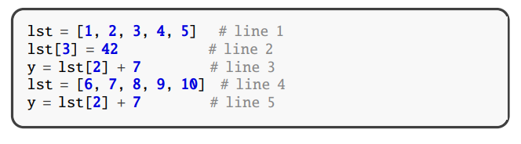
Data Dependency Representation Model
nbslicer represents data dependencies at the granularity of "symbols"
Symbol - represents the basic unit of data that can participate in a data dependency. Each symbol is a node in the data dependency graph. For example, lst and lst[2] are symbols.
1. Each symbol can have child symbols tracking fields- lst has child symbols lst[2] and lst[3] in its namespace.
Remember! Each symbol is associated with up to two namespaces (structured container for organizing and managing symbols within specific scopes or contexts), to represent nested data
Notes:
Here, "symbol" represents the basic unit of data that can participate in a data dependency.
Each symbol is a node in the data dependency graph. For example, lst and lst[2] are symbols. Each symbol is associated with up to two namespaces, to represent nested data. Each symbol can have child symbols – here, lst has child symbols lst[2] and lst[3].
The model used to represent data dependencies

Slide 30
Data Dependency Representation Model
Symbol - represents the basic unit of data that can participate in a data dependency.
2. Child symbols are implicitly dependent on their parent symbol - lst[2] depends on lst.
Remember! Each symbol is associated with up to two namespaces (structured container for organizing and managing symbols within specific scopes or contexts), to represent nested data
This representation is essential to annotate dynamic dependencies, and later, symbols are used to effectively resolve the data dependencies.
Notes:
Child symbols are dependent on their parent symbol – here, lst[2] depends on lst.
This symbol representation, helps NBslicer capture field-granular data dependencies.
This representation is essential during the Instrumentation Phase to annotate dynamic dependencies, and later during the Dependency Resolution Phase, symbols are used to effectively resolve and understand the data dependencies for constructing accurate slices in computational notebooks.
This structured representation of symbols helps in accurately resolving data dependencies during the Dependency Resolution Phase.
A "field" refers to an individual element within a data structure like a list, dictionary, object, etc. For example, a single array index in a list or a single object property. "Field-granular" means tracking dependencies at the granularity of individual fields (individual element within a data structure) within data structures.

Slide 31
Static Resolution
For simple cases, data dependencies can be captured solely via statically analyzing code. However, static analysis has limitations when it comes to handling additional dynamic behavior.
✔
✖
x = lst[42] | x = lst[y] | x = lst[f()]
Nbslicer static dependency reslover is able to directly draw a data dependency edge between x and lst[42] by inspecting the AST. | Nbslicer static dependency reslover is (possibly) able to directly draw a data dependency edge between x and lst[42] by inspecting the AST- if we have the additional knowledge that y equals to 42 at runtime. | NBslicer static dependency reslover is not able to directly draw a data dependency edge between x and lst[42] . In the general case there is no way to know what f will do without actually running it.
✔
Notes:
For simple cases, data dependencies can be inferred by only using static analysis. However, static analysis can get us only so far in the case of additional dynamic behavior:
Let’s look on a simple case, x = lst[42]. For such a simple case, nbslicer is able to directly draw a data dependency edge between x and lst[42] by inspecting the AST.
Now, x = lst[y]. Here it is still possible to draw the data dependency just by statically inspecting the code, if we have the additional knowledge that y equals to 42 at runtime.
However, for the case x = lst[f()], in the general case there is no way to know exactly what f will do without actually running it.

Slide 32

Static Resolution – Quick Summary
The static resolver relies on additional dynamic instrumentation.
The dynamic instrumentation decorates the AST with resolve symbol information.
When the static resolver encounters these decorated subtrees, it uses dynamic metadata to draw dependencies instead of trying to statically analyze the code.
In this way, the static resolver leverages the runtime instrumentation to act as a dynamic dependency resolver.
Notes:
The static resolver relies on additional dynamic instrumentation.
This instrumentation decorates the AST with resolved symbol information.
When the static resolver encounters these decorated subtrees, it uses the dynamic metadata information to draw dependencies instead of trying to statically analyze the code.
In this way, the static resolver leverages the runtime instrumentation.

Slide 33
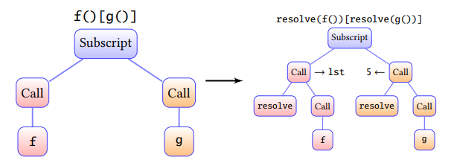
Dynamic Data Dependency Resolution
NBslicer embeds tracing instrumentation directly into the source code. The tracing instrumentation transforms the AST to insert resolve() calls.
The resolve() calls execute dynamic behavior, such as functions.
Reminder - "symbol information" refers to metadata about variables and data elements that is used to capture dependencies
Later, The resolve() calls decorate the AST with symbol information, and by that handle those parts in the AST that can not be statically resolved.
It allows the static resolver to draw accurate dependencies, functioning as a dynamic resolver.
AST transformation and symbol resolution example:
Notes:
NBslicer embeds tracing instrumentation directly into the source code.
The goal of this instrumentation is to trace dynamic behavior.
The tracing instrumentation transforms the AST to insert resolve() calls.
The resolve() calls execute dynamic behavior, such as functions
The “resolve” symbols decorate the AST with symbol information, and by that handle the parts in the AST that can be statically resolved
The resolve() calls dynamically track reads and writes to symbols when that code executes

Slide 34
Suppose we have two functions, f and g, f return a list lst and g returns constant 5. To instrument the code x = f()[g()], nbslicer rewrites it as: x = resolve(f())[resolve(g())]
The resolve() calls handle subtrees that cannot be statically analyzed. They decorate the roots of these subtrees with symbol information.
This allows the static dependency resolver to function as a dynamic resolver - the static dependency resolver then treat those subtrees as having dynamic dependencies resolved.
AST transformation and symbol resolution example:
Notes:
This allows the static dependency resolver to function as a dynamic resolver - when it reaches a resolve() call, it draws edges based on the dynamically resolved symbols rather than trying to statically analyze the subtree.

Slide 35


Switchable Instrumentation
We disable the instrumentation for:
1. After the first run of a statement like a loop body, further iterations are uninstrumented
2. calls to external libraries, that their code is defined outside the notebook context. Users can override the rules through an annotation DSL.
Those rules bound the additional overhead
Notes:
We disable the instrumentation for: (i) for program statements that have run before, and for (ii) calls to external libraries, that their code is defined outside the notebook context. Those rules bound the additional overhead.

Slide 36
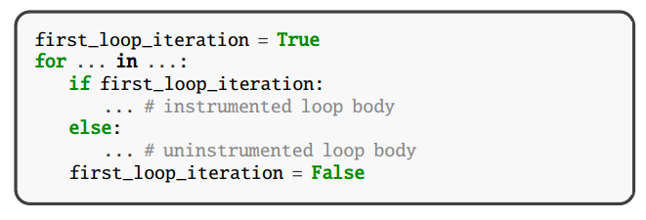
NBslicer instruments code to only run instrumentation on the first execution of statements. This is realized by rewriting, e.g., for loops. For example:
If the body loop contains conditionals branches, any branches not initially taken will have a corresponding AST; For such cases, the dependency resolution will fall back to static behavior
Notes:
To reduce overhead, NBslicer only runs instrumentation on the first execution of statements.
This is realized by rewriting, for example, loops.
If the body loop contains conditionals branches, any branches not initially taken will have corresponding AST For such cases, the dependency resolution will fall back to static behavior

Slide 37

Rule-Based Dependency Inference for Libraries
To reduce overhead, NBslicer does not instrument code from external libraries. However, library calls can still introduce data dependencies that need to be captured.
Reminder - Modification of the state by a function, means it changes the values of variables or objects beyond its own scope.
NBslicer handles external libraries calls using two simple rules:
Calls that return a value are assumed to not mutate state or introduce dependencies.
Calls that return None are assumed to potentially mutate state and introduce dependencies from arguments to the mutated object.
Notes:
nbslicer does not analyze code from external libraries. However, library calls can still introduce data dependencies. Nbslicer handles those calls using two simple rules:
Calls that return a value are assumed to not modify the state
Calls that return None are assumed to potentially mutate state and introduce dependencies.
Modification of the state by a function means it changes the values of variables or objects beyond its own scope.

Slide 38

EMPIRICAL STUDY
computational overhead
Slice size
Notes:
We are going to evaluate nbslicer’s effectiveness in two dimensions: slice size and computational overhead. (תקורה) The authors ran two sets of experiments: 1. one to evaluate slice size by comparing nbslicer to nbgather , a static slicer for computational notebooks in Python that uses the IPython kernel. 2. and another one to evaluate nbslicer’s computational overhead compared to a regular IPython kernel with no extensions.

Slide 39
Metrics
Slice Size Ratio - For a notebook session S and slice T ⊆S, the slice size ratio is defined as the number of statements in that slice divided by the number of statements in the full session, |T |/|S |. Assuming equivalent execution results, smaller slice sizes are preferred because they require less time to execute and are more readable.
Session Latency and Overhead - The session latency is defined as the notebook execution time under different methods. We define the calculation of overhead as the nbslicer session latency divided by the IPython session latency.
Notes:
Slice Size Ratio - the slice size ratio is defined as the number of statements in that slice divided by the number of statements in the full session. smaller slices are preferred because they run faster and are more readable.
the Overhead - is measured by the notebook execution time under different methods.

Slide 40
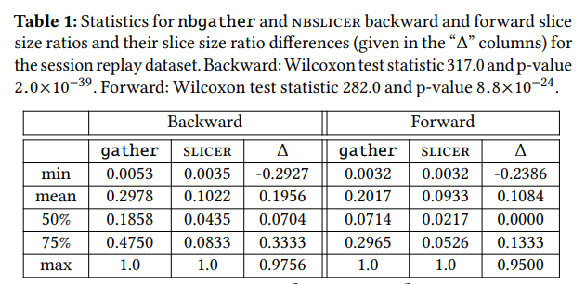








Slice Size Ratios Results
)reminder( The slice size ratio is the number of statements in the slice divided by the total statements in the notebook session. Lower is better.
The result: For both backward and forward slices, nbslicer results in much smaller slice size ratios on average.
On average, NBslicer backward slices are 66% smaller ( (0.1956 / 0.2978) * 100 = 66% ) , and forward slices are 54% smaller ( (0.1084 / 0.2017) * 100 = 54% ) . (calculation of precent reduction)
Notes:
So, NBslicer results in much smaller slice size ratios on average for both backward and forward slices. As you can see, on average, backward slices are 66% smaller, and forward slices are 54% smaller. Percent reduction: (0.1956 / 0.2978) * 100 = 66% Percent reduction: (0.1084 / 0.2017) * 100 = 54%

Slide 41
Static vs Dynamic Slicer Results
Slice Correctness - nbslicer’s slices correctly reproduced any printed output of the last statement in the original program . One benefit of our dynamic slicer is that it will not include statements that result in runtime errors in a slice, while static slices might include such statements.
Slice Performance Benefits - The authors computed the runtime improvement for nbslicer from the execution times of the slices . On average, an nbslicer slice executed 1.34× faster than an nbgather slice.
Notes:
Both slicers constructed a list of statement dependencies. For each slice, we concatenate the statements to compute slice size.

Slide 42
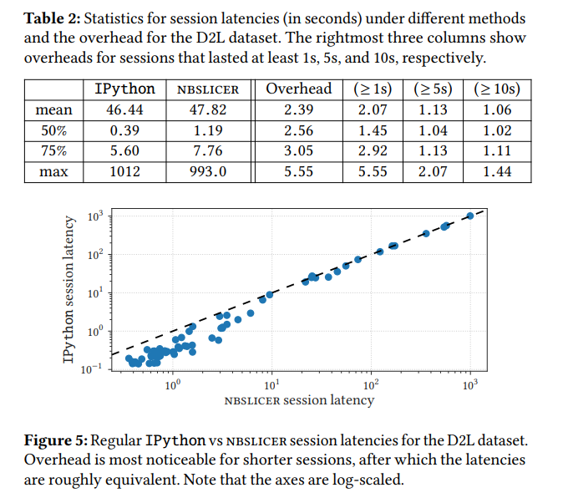



Computational Overhead Results
Recall that nbgather, which is based on static slicing, uses the IPython kernel directly and does not have additional runtime overhead.
The mean session latency (total runtime) is 46.44 seconds with regular IPython and 47.82 seconds with nbslicer. So on average, nbslicer is only adding 1.38 seconds of overhead.
The max overhead ratio is 5.55. It was seen in a session that was less than 1 second long with IPython. This suggests short sessions see higher overhead.
Notes:
Recall that nbgather, which uses the IPython kernel, doesn’t have additional runtime overhead. The mean session latency is 46.44 seconds with IPython and 47.82 seconds with nbslicer. So on average, nbslicer is only adding 1.38 seconds of overhead.
The max overhead ratio is 5.55. This maximum overhead ratio, was seen in a session that was less than 1 second long with IPython. The results suggest that short sessions see higher overhead in NBslicer.

Slide 43
scatter plot comparing the session execution times (latencies) of IPython versus nbslicer :
Each point represents a notebook session.
Observation: nbslicer's instrumentation overhead has much more impact on short sessions, while longer sessions have comparable runtimes between the two configurations. This matches the results from Table 2.
Notes:
Figure 5 shows a scatter plot comparing the latencies of IPython and nbslicer.
Each point represents a notebook session.
For longer sessions, the points begin clustering closer to the y=x line, meaning the latencies are similar.
Here is an observation from the scatter plot – nbslicer's overhead has much more impact on shorter sessions It also matches the results from Table 2.

Slide 44
Computational Overhead Results - Conclusions
Table 2 and Figure 5 indicate that nbslicer session latency is higher than IPython for shorter sessions, and roughly equivalent for longer sessions. However, the user will probably not feel most of the slowdowns in an interactive notebook setting.
Although the experimental scripts programmatically executed the code cells in a notebook session, in practice, users manually run cells through an interface, with some time passing in between cell runs. This “time passing " would increase the notebook session runtime but not necessarily the Nbslicer overhead, contributing to a smaller effective overhead in practice.
Notes:
Nbslicer latency is higher for shorter sessions, and roughly equivalent for longer sessions. However, the user probably will not feel most of the slowdowns in an interactive notebook setting. Users manually run cells ,with some time passing in between cell runs. This “time passing " would increase the notebook session runtime but not necessarily the Nbslicer overhead, contributing to a better overhead in practice. overhead is any combination of excess or indirect computation time, memory, bandwidth, or other resources that are required to perform a specific task.

Slide 45

Summary
Computational notebooks are often becoming messy.
Current solutions involve traditional static slicing approaches
We met Nbslicer, hybrid static-dynamic slicer for computational notebooks.
Nbslicer aims to provide more accurate and compact slices while keeping balance between performance and portability.
Notes:
Computational notebooks are often becoming messy, leading to ineffectiveness and confusion.
Current solutions involve static program slicing techniques, but they are limited.
We met Nbslicer, hybrid static-dynamic slicer for computational notebooks. Nbslicer aims to create small and accurate program slices, while balancing between performance and portability.

Slide 46
Summary
Nbslicer leverages the abstract syntax tree (AST) instrumentation for dynamic data dependency resolution.
Nbslicer improves both backward and forward slicing by 66% and 54%, respectively.
Nbslicer overhead is a little higher for shorter sessions, and roughly equivalent for longer sessions.
My take on the paper -I appreciate the authors' acknowledgment of the potential overhead and their practical solution of making the instrument switchable. This realistic approach adds usability to the tool, making it a valuable feature for users who may need to disable it to manage performance concerns.
Notes:
Nbslicer leverages the AST instrumentation to resolve dynamic data dependency. It improves both backward and forward slicing by 66% and 54% smaller slices.
Nbslicer overhead is a little higher for shorter sessions, and roughly equivalent for longer sessions.
My take on the paper – I appreciate that the developers acknowledged that users might want to disable the instrument due to overhead, so they made it switchable.
I liked that the authors considered users might want to turn off the tool because of the overhead. Making it switchable is a practical and useful feature

Slide 47

Data Management
Organization: Nbslicer enhances the organization of data science workflows within computational notebooks.
Reproducibility: Through dynamic program slicing, nbslicer aids in constructing smaller, accurate code slices, improving reproducibility.
Efficiency: By addressing the challenges of accumulating code and hidden state, nbslicer streamlines notebook iteration for more efficient data science tasks.
Dependency Management: Nbslicer assists in managing dynamic dependencies, crucial for maintaining consistency in exploratory data analyses.
Lineage Reasoning: The tool helps data scientists reason about the lineage of code, contributing to better data management practices in interactive computational environments.

Slide 48
Further research
Develop heuristics to automatically configure trace-once semantics to balance performance and completeness.
Apply the techniques to other interactive programming environments beyond notebooks.
Extend the techniques to support other languages commonly used in notebooks like R.
Notes:
Further work could be on extending this tool to other languages commonly used in notebooks like R.

Slide 49
How Nbslicer Works- Step by Step
Step 1: Instrumentation Phase
As a user executes code cells in the notebook, nbslicer transforms the abstract syntax trees (ASTs) of the code by injecting instrumentation calls.
These instrumentation calls trace dynamic data dependencies and annotate areas of the ASTs that cannot be statically analyzed.
Step 2: Dependency Resolution Phase
When the user executes a slice command, nbslicer runs its hybrid static-dynamic dependency resolver.
It first checks AST subtrees for dynamic dependency information attached during instrumentation. If found, it uses that. If not, it falls back to static analysis using the rules-based approach for external libraries.
The enriched AST allows resolving direct data dependencies between symbols.
Notes:
Instrumentation Phase
As a user executes code cells in the notebook, nbslicer transforms the abstract syntax trees (ASTs) of the code by injecting instrumentation calls.
These instrumentation calls trace data dependencies and annotate areas of the ASTs that cannot be statically analyzed.
Dependency Resolution Phase
When the user executes a slice command, nbslicer runs its hybrid static-dynamic dependency resolver.
It first checks AST subtrees for dynamic dependency information attached during instrumentation. If found, it uses that.
If not, it falls back to static analysis using the rules-based approach for external libraries.
The enriched AST allows resolving direct data dependencies between symbols.

Slide 50
How Nbslicer works- Step by Step
Step 3: Slice Construction Phase
Using the resolved dependencies, nbslicer constructs a backward or forward slice via transitive closure over relevant cells.
The cells containing statements that are transitively dependent on the sliced statement (for backward) or vice versa (for forward) are included in the slice.
Step 4: Slice Execution Phase
The constructed slice extracting only relevant cells can then be executed.
Outputs should match the original notebook, but with less unnecessary computation.
Notes:
Slice Construction Phase
Using the resolved dependencies, nbslicer constructs a backward or forward slice via transitive closure over relevant cells.
The cells containing statements that are transitively dependent on the sliced statement (for backward) or vice versa (for forward) are included in the slice.
Slice Execution Phase
The constructed slice extracting only relevant cells can then be executed.
Outputs should match the original notebook, but with less unnecessary computation.

Slide 51


Thank you for listening!
Game PIN
04115631
Notes:
https://kahoot.it/challenge/04115631?challenge-id=6d04d3ec-0d80-4e87-8df6-ee73a4ed4047_1706017859330 Game PIN
04115631

Slide 52
References
1. https://en.wikipedia.org/wiki/Program_slicing 2. https://en.wikipedia.org/wiki/Abstract_syntax_tree 3. https://medium.com/hootsuite-engineering/static-analysis-using-asts-ebcd170c955e 4. https://www.geeksforgeeks.org/software-engineering-slicing/ 5.https://www.techtarget.com/whatis/definition/bytecode#:~:text=Bytecode%20is%20computer%20object%20code,bytecode%20for%20the%20target%20platform.
6. https://dl.acm.org/doi/fullHtml/10.1145/3290605.3300500
7. https://www.youtube.com/watch?v=cpADNWjNvkU
8. https://www.microsoft.com/en-us/research/uploads/prod/2019/01/Managing_Exploratory_Messes_in_Computational_Notebooks-2.pdf

Slide 53
Q&A
Q1: Is it possible that Nbslicer incorrectly assume an external function does not modify state when in reality it does ?
A1: Yes, it is possible that nbslicer could incorrectly assume an external function does not modify state when in reality it does. The authors state that to maintain soundness, nbslicer requires external libraries used in the notebook to be annotated via the dependency DSL to describe their side effects. Without proper annotations, cases could arise where nbslicer assumes no state mutation from a function call, but state actually does get modified.
In such cases, the correctness of slices cannot be guaranteed. The paper notes that nbslicer makes no guarantees regarding soundness when interacting with state external to the notebook itself, like files that could be mutated by other processes. In practice correctness appears mostly preserved.
Q2: How does NBslicer knows that some external libraries than don’t modify the state ?
A2: NBslicer leverages a rules-based approach and declarative DSL to determine when external library calls modify state vs. when they do not. These external calls can still introduce data dependencies that need to be captured. So nbslicer uses simple rule-based heuristics to handle these cases. As an example, by default it assumes external library calls that return a value do not modify state, while calls returning None do modify state.
Notes:
Q1: Is it possible that Nbslicer incorrectly assume an external function does not modify state when in reality it does ?
A1: Yes, it is possible that nbslicer could incorrectly assume an external function does not modify state when in reality it does. The authors state that to maintain soundness, nbslicer requires external libraries used in the notebook to be annotated via the dependency DSL to describe their side effects. Without proper annotations, cases could arise where nbslicer assumes no state mutation from a function call, but state actually does get modified.
In such cases, the correctness of slices cannot be guaranteed. The paper notes that nbslicer makes no guarantees regarding soundness when interacting with state external to the notebook itself, like files that could be mutated by other processes. In practice correctness appears mostly preserved.
Q2: In the article, how does NBslicer knows that some external libraries than don’t modify the state ?
A2: NBslicer leverages a rules-based approach and declarative DSL to determine when external library calls modify state vs. when they do not. These external calls can still introduce data dependencies that need to be captured. So nbslicer uses simple rule-based heuristics to handle these cases. As an example, by default it assumes external library calls that return a value do not modify state, while calls returning None do modify state.
Swithcable instrumentation -
It is for this reason that Nbslicer operates at the level of the program’s AST rather than at the level of bytecode. an instrumented AST can reference its original form. On the other hand, bytecode lacks metadata for linking with the program's AST.

Slide 54
Q&A
Q3: What is the meaning of performance and the meaning of portability ?
A3: Performance refers to the runtime/execution speed and overhead induced by the dynamic slicing instrumentation. The paper mentions dynamic slicing can introduce significant overhead, slowing down execution speed by 100x or more.
Portability: refers to the ability of the dynamic slicing implementation to work seamlessly across different systems and versions.
the tradeoff is between:
Performance: Keeping the runtime overhead low and interactive speeds fast.
Portability: Making the dynamic slicer easy to install/use like a regular Python library without requiring a custom interpreter or environment.
Q4: How does NBslicer calculate data dependencies?
A4: It uses a hybrid of static analysis of ASTs combined with dynamic instrumentation to enrich the ASTs with runtime data dependencies.
Q5: Does NBslicer modify the Python interpreter?
A5: No, the AST instrumentation is completely bolt-on and portable across Python versions. This contrasts with some prior dynamic slicing approaches.
Notes:
Q3: What is the meaning of performance and the meaning of portability in that context ?
A3: Performance refers to the runtime/execution speed and overhead induced by the dynamic slicing instrumentation. The paper mentions dynamic slicing can introduce significant overhead, slowing down execution speed by 100x or more. Portability: refers to the ability of the dynamic slicing implementation to work seamlessly across different systems and versions.
the tradeoff is between:
Performance: Keeping the runtime overhead low and interactive speeds fast.
Portability: Making the dynamic slicer easy to install/use like a regular Python library without requiring a custom interpreter or environment.
jupyter kernel - a computing engine that executes the code contained in jupyter notebook. The slicer is an on-demand tool that operates when the user activates it, rather than running as a continuous background process.

Slide 55
Q&A
Q6: how the "resolve" calls handle dynamic data dependencies ?
A6: The "resolve" calls in nbslicer are key to how it handles dynamic data dependencies when computing program slices. Here are the main steps:
Identify parts of the AST with dynamic behavior
Analyze values and dependencies at runtime
Decorate the AST with dependencies: resolve() then decorates the corresponding AST subtree with the dynamic dependency information it found. For example, adding edges between symbols read/written within a function call.
Short-circuit static analysis: Later when the static analyzer reaches the decorated subtree, it will skip over it. So resolve() signals where the static analysis can be short-circuited.
Construct accurate slice: Using the dependencies from both static and dynamic phases, nbslicer constructs a more accurate program slice.
Q7: Is the program dependency graph and the AST are the same ? if not, what is the connection between them ?
A7: No, the program dependency graph and the abstract syntax tree (AST) are not the same thing. In summary:
AST: structure of source code
Dependency graph: dependencies between symbols and cells. In the context of nbslicer, each node in the dependency graph typically corresponds to a symbol.
The AST instrumentation feeds dynamic dependency data into the graph
So they work together, but model different aspects of the program.
Notes:
Q6: how the "resolve" calls handle dynamic data depandancies ?
A6: The "resolve" calls in nbslicer are key to how it handles dynamic data dependencies when computing program slices. Here are the main steps:
Identify parts of the AST with dynamic behavior
Analyze values and dependencies at runtime
Decorate the AST with dependencies: :resolve() then decorates the corresponding AST subtree with the dynamic dependency information it found. For example, adding edges between symbols read/written within a function call.
Short-circuit static analysis: Later when the static analyzer reaches the decorated subtree, it will skip over it. So resolve() signals where the static analysis can be short-circuited.
Construct accurate slice: Using the dependencies from both static and dynamic phases, nbslicer constructs a more accurate program slice.
Q7: Is the program dependency graph and the AST are the same ? if not, what is the connection between them ?
A7: No, the program dependency graph and the abstract syntax tree (AST) are not the same thing. In summary:
AST: structure of source code
Dependency graph: dependencies between symbols and cells
The AST instrumentation feeds dynamic dependency data into the graph
So they work together, but model different aspects of the program.

Slide 56
Q&A
Q8: What “resolve” calls do ?
A8: The "resolved" calls in nbslicer execute functions with dynamic behavior, capture their results, and annotate the abstract syntax tree with symbol information. This allows the static resolver to incorporate dynamic dependencies during analysis, enhancing the understanding of data dependencies in notebook code.
Q9: what does it means that the resolve() symbols decorated the AST with symbol information
Dynamic Execution: The resolve() calls execute dynamic behavior, such as function calls f() and g().
Capture Symbol Information: During this dynamic execution, the values or symbols resulting from the dynamic behavior are captured.
Decoration of AST Nodes: The captured symbol information is then associated or "decorated" with the nodes in the AST that correspond to the points where dynamic behavior occurred. For example, if there's a node in the AST representing the result of f(), the symbol information from the execution of resolve(f()) is attached to or associated with that AST node.
Symbol-Aware AST:
The AST, which is a representation of the code's syntactic structure, becomes "symbol-aware" as it now carries additional information about the symbols generated or affected by dynamic behavior.
This symbol information allows the AST to serve as a more comprehensive representation of the code, incorporating both static and dynamic aspects.
Utilized by Static Dependency Resolver:
When the static dependency resolver encounters these decorated AST nodes during its analysis, it can leverage the associated symbol information.
The symbol information helps the static resolver understand the relationships and dependencies between symbols, even in areas of the code where static analysis alone might fall short.
In summary, decorating the AST with symbol information means enhancing the AST nodes with details about the symbols produced or influenced by dynamic execution. This augmented AST then aids the static dependency resolver in accurately capturing data dependencies, creating a more complete picture of the code's behavior.
Notes:
Q8: What “resolve” calls do ?
A8: The "resolved" calls in nbslicer execute functions with dynamic behavior, capture their results, and annotate the abstract syntax tree with symbol information. This allows the static resolver to incorporate dynamic dependencies during analysis, enhancing the understanding of data dependencies in notebook code.
Here's a breakdown:
Dynamic Execution:
The resolve() calls execute dynamic behavior, such as function calls f() and g().
Capture Symbol Information:
During this dynamic execution, the values or symbols resulting from the dynamic behavior are captured.
Decoration of AST Nodes:
The captured symbol information is then associated or "decorated" with the nodes in the AST that correspond to the points where dynamic behavior occurred.
For example, if there's a node in the AST representing the result of f(), the symbol information from the execution of resolve(f()) is attached to or associated with that AST node.
Symbol-Aware AST:
The AST, which is a representation of the code's syntactic structure, becomes "symbol-aware" as it now carries additional information about the symbols generated or affected by dynamic behavior.
This symbol information allows the AST to serve as a more comprehensive representation of the code, incorporating both static and dynamic aspects.
Utilized by Static Dependency Resolver:
When the static dependency resolver encounters these decorated AST nodes during its analysis, it can leverage the associated symbol information.
The symbol information helps the static resolver understand the relationships and dependencies between symbols, even in areas of the code where static analysis alone might fall short.
In summary, decorating the AST with symbol information means enhancing the AST nodes with details about the symbols produced or influenced by dynamic execution. This augmented AST then aids the static dependency resolver in accurately capturing data dependencies, creating a more complete picture of the code's behavior.

Slide 57
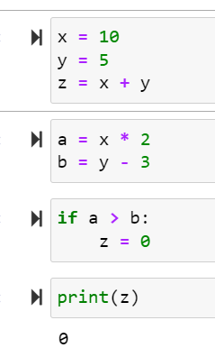
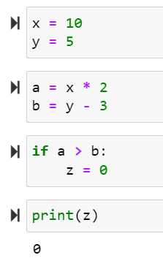

Dynamic Backward Program Slice Construction Example
The program slice , with respect to print(z) statement:
z = x + y statement is overwritten in the if statement, so it does not contribute to the final value.
Notes:
Lets take a look at the code on the right side. If we take a backward slice with respect to the print(z) statement, the backward program slice analysis would be like this:
z depends on the if statement
The if statement depends on a and b
a depends on x
b depends on y
the line that calculate z = x + y originally are NOT included in the slice. This is because that statement is overwritten in the if statement, so it does not contribute to the final value. Any unused or overwritten lines are left out of the program slice.

Slide 58
Cell - Level Slicing
For program slicing, we usually have to consider both data dependencies and data control, to determine which statements get executed.
in NBslicer, we only consider data dependencies. This decision simplified the design
The idea: we construct slices at cell-granularity, since cells already logically separate the notebook, and control dependencies never exist between statements in separate cells.
If finer granularity is desired, note that we can simply treat each module-level as being in its own “virtual” cell
Notes:
For traditional program slicing, we have to consider both data dependencies and control dependencies in order to determine which statements actually get executed; however, in nbslicer, we only consider data dependencies. The novel idea is that we construct slices at cell-granularity, since cells already logically separate the notebook. By designing our slicer to include or exclude blocks of code at cell-level granularity, we bypass the issue of control dependencies altogether without sacrificing correctness, since control dependencies never exist between statements in separate cells. If finer granularity is desired, note that we can simply treat each module-level, or outermost program statement as being in its own “virtual” cell

Slide 59
Soundness and Completeness Assumptions of Nbslicer.
A slicer is sound if it never incorrectly excludes code that should be in the slice, and it is complete if it correctly excludes all the code that should not appear in the slice.
To maintain soundness, NBslicer requires that any used libraries external to the notebook be noted to describe their side effects.
In addition, NBslicer does allow trading soundness for completeness in some cases as a configuration option
Notes:
a slicer is sound if it never incorrectly excludes code that should be in the slice, and it is complete if it correctly excludes all the code that should not appear in the slice. To maintain soundness, nbslicer requires that any used libraries external to the notebook be annotated to describe their side effects. Additionally, NBslicer does allow trading soundness for completeness in some cases as a confguration option. Finally, nbslicer makes no guarantees regarding soundness when interacting with state external to the notebook, such as files that could be mutated by external processes. Despite of these limitations, nbslicer is still capable of producing useful slices that reproduce desired outputs.

Slide 60
DSL for Exceptions to the Rule-Based Resolver
When nbslicer encounters a call to a function or method, it first attempts to match the provided arguments in the signature with symbol metadata from the notebook. Subsequently, it takes action in accordance with the specified return type.
Notes:
Although our rule-based heuristics are accurate for most calls to external libraries, they do not capture all cases perfectly. To handle exceptions, nbslicer provides a declarative DSL based on Python annotations for specifying how functions and class methods from modules outside the notebook mutate the caller or other arguments and when they do not.
While this works in most cases, there are exceptions. To handle these, nbslicer provides a domain-specific language (DSL) based on Python annotations. The DSL allows specifying per-function:
Arguments to match against notebook symbols
Return value behaviors (no effect, mutation, etc.)
This overrides the default rules when needed to handle tricky cases correctly.
In summary, a rules system combined with an annotation DSL allows nbslicer to infer dependencies from uninstrumented library calls fairly accurately.

